Slide 1

RedTeam Village
The ADCS domain Admin is right there

Slide 2
About ME
My name is Fabrício Gimenes (FgP)
I have 9 years of experience in Offensive Security.
I love privilege escalation techinics like “Domain Admin” and some other types of Bypass like EDR and Windows Defender especially ☺ .
Do you know why I like privilege escalation?
“Why isn’t there anything you do shit with other users”
I have some security certifications like OSCP and OSWE.
Linkedin
https://www.linkedin.com/in/fabricio-gimenes-93bb6828/
Twitter
@donotouchplease

Slide 3
Disclaimer
Nothing I say here represents my company, that is, all shit is my responsibility

Slide 4
The motivation
As I mentioned before, one of my favorite techniques is privilege escalation, so I decided to set up a LAB where I could find new techniques to become a domain admin. And that's when I found an excellent article from Specterops where they talked about ADCS
So, for my happiness good things happening!!!!
Look out for upcoming sleds ☺
References
https://posts.specterops.io/certified-pre-owned-d95910965cd2

Slide 5
Agenda
ADCS – Concept​
Templates​
​
Attacks ADCS​
ESC1​
Missing configuration Templates
​
ESC8​
Back to the Basic – NTLM​
Back to the Basic – ESF and RPC
ESC7 – Yes, I’m CA Manager​
Mitigations

Slide 6
What’s ADCS?​
Active Directory Certificate Services (ADCS) ​
​
ADCS provides customizable services for issuing and managing public key infrastructure (PKI) certificates used in software security systems that employ public key technologies. ​
The digital certificates that AD CS provides can be used to encrypt and digitally sign electronic documents and messages. Further, these digital certificates can be used for authentication of the computer, user or device accounts on a network. Digital certificates are used to provide:​
​
1) Confidentiality - through encryption​
2) Integrity - through digital signatures​
3) Authentication - by associating certificate keys with the computer, user, or device accounts on a computer network.​
​
These certificate services were available starting in Windows 2000 and continue to be available as a server role in Windows Server 2008 R2.​

Slide 7
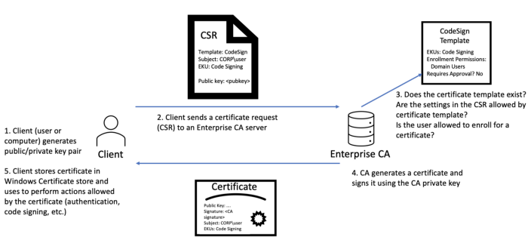
Certificate Enrollment

Slide 8
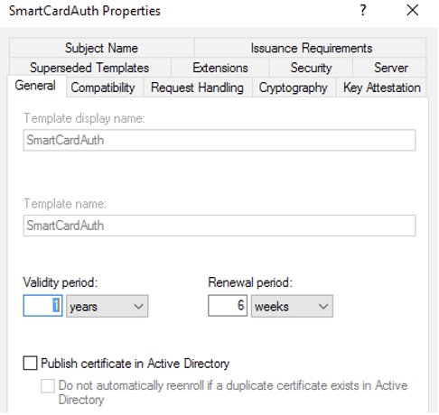
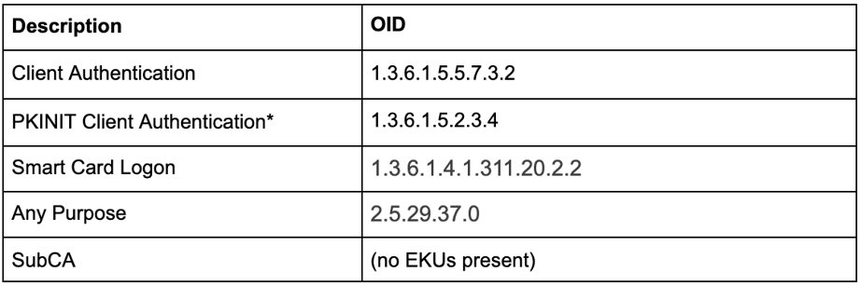
Templates
​AD CS Enterprise CAs issue certificates with settings defined by AD objects known as certificate templates. These templates are collections of enrollment policies and predefined certificate settings and contain things like “How long is this certificate valid for?”, “What is the certificate used for?”, “How is the subject specified?”, “Who is allowed to request a certificate?”, and a myriad of other settings:​
The pKIExtendedKeyUsage attribute on an AD certificate template object contains an array of object identifiers (OIDs) enabled for the template. These EKU object identifiers affect what the certificate can be used focused on EKUs that, when present in a certificate, permit authentication to Active Directory. We originally thought that only the “Client Authentication“ OID (1.3.6.1.5.5.7.3.2) enabled this; however, our research also found that the following OID scenarios can enable certificate-based authentication:​

Slide 9
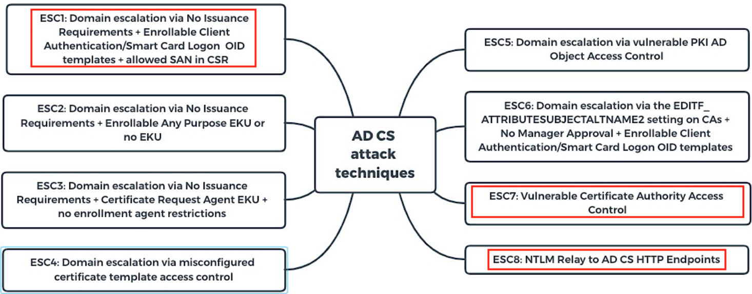
Abusing Active Directory Certification Services
Reference
https://posts.specterops.io/certified-pre-owned-d95910965cd2

Slide 10
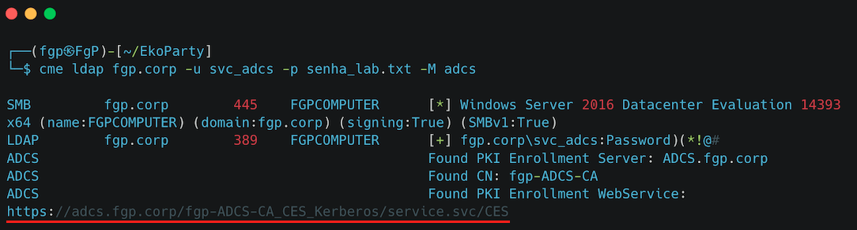
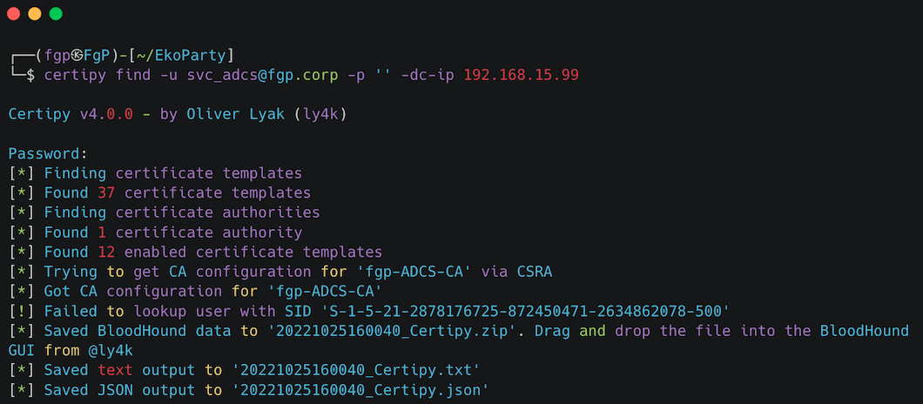
ADCS – Missing Configuration - Recon
The first thing we must do is identify some internals ADCS, to do this we can use different tools such as “crackmapexec and certipy” as we can see in the image below.
CRACKMAPEXEC
CERTIPY 4.0

Slide 11
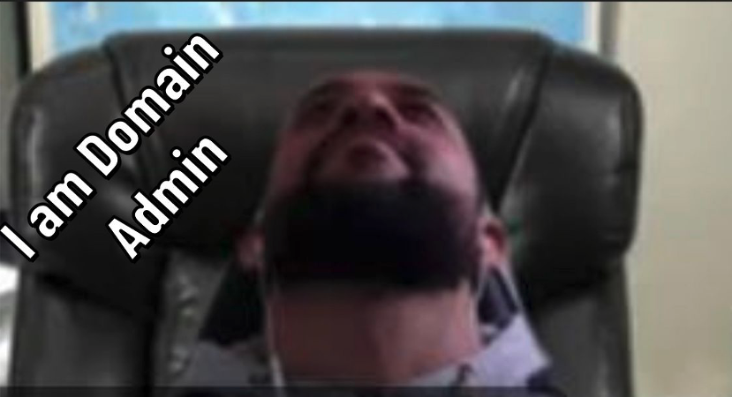
Did you say domain admin? I am here

Slide 12
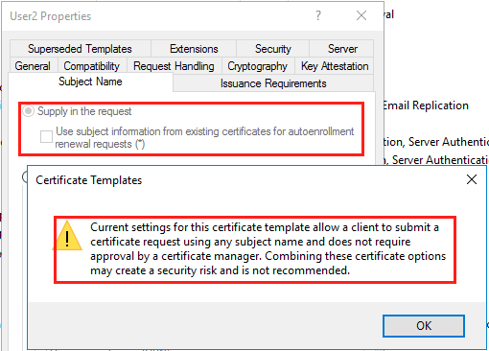
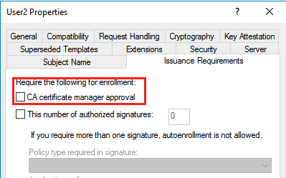
ESC1 — Misconfigured Certificate Templates​
There is a specific set of settings for certificate templates that makes them extremely vulnerable. As in regular-domain-user-to-domain-admin vulnerable. The first scenario (ESC1) that results in this vulnerable configuration is as follows: ​
• The Enterprise CA grants low-privileged users enrollment rights. The Enterprise CA’s configuration must permit low-privileged users the ability to request certificates. See the “Enrollment Rights and Protocols” section at the beginning of this paper for more details. ​
​• Manager approval is disabled. This setting necessitates that a user with CA “manager” permissions review and approve the requested certificate before the certificate is issued. See the “Manager Approval” section at the beginning of this paper for more details. ​
​• No authorized signatures are required. This setting requires any CSR to be signed by an existing authorized certificate. See the “Enrollment Agents, Authorized Signatures, and Application Policies” section at the beginning of this paper for more details. ​
​• An overly permissive certificate template security descriptor grants certificate enrollment rights to low-privileged users. Having certificate enrollment rights allows a low-privileged attacker to request and obtain a certificate based on the template. Enrollment Rights are granted via the certificate template AD object’s security descriptor. ​
Subject Name
PKI don't need Manager Approval

Slide 13
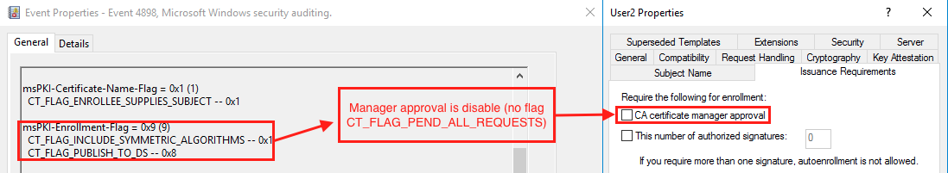
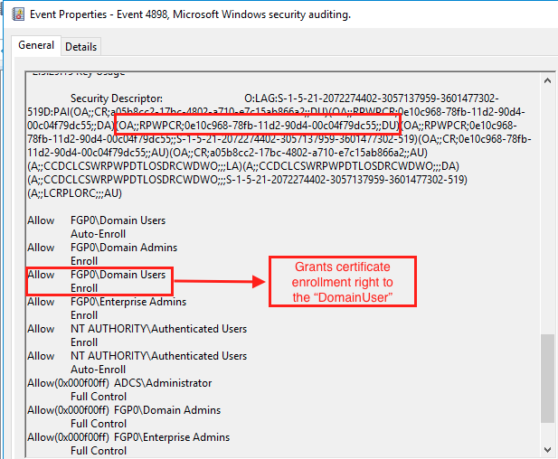
Certificate template that vulnerable to the ESC1 technique EventID
Unfortunately, there is no simple way to monitor requesting the certificates, but we can use the Windows Event Log to help us identify the arbitrary SAN.
EventID 4898
Grants certificate enrollment right to the “Domain Users”
But IMPORTANT, It is important to note thar 4898 event is not suitable for real time. ☹
At the time of the first enrollment since CA service start
At the time of the first enrollment since certificate template modification

Slide 14
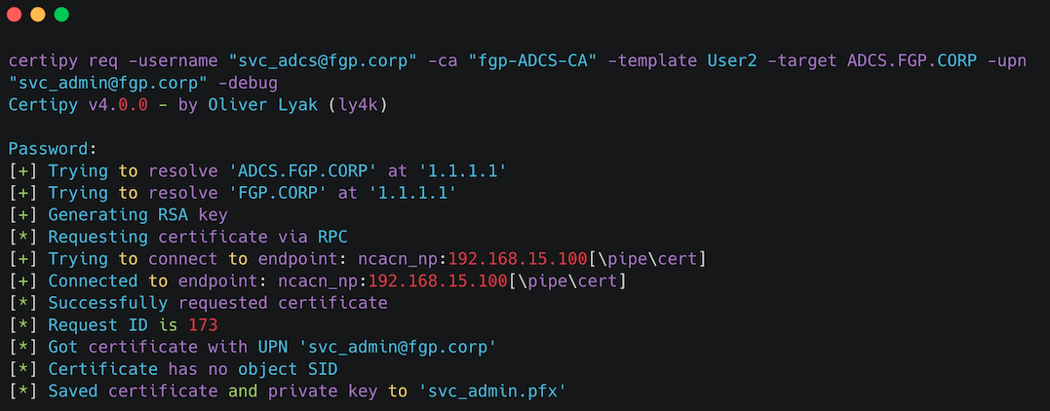
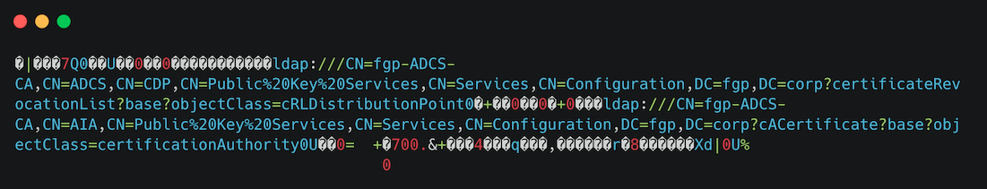
ESC1 — Content Certificate
When we requested the new certificate to another user we can obtain “public key and private key” together.

Slide 15
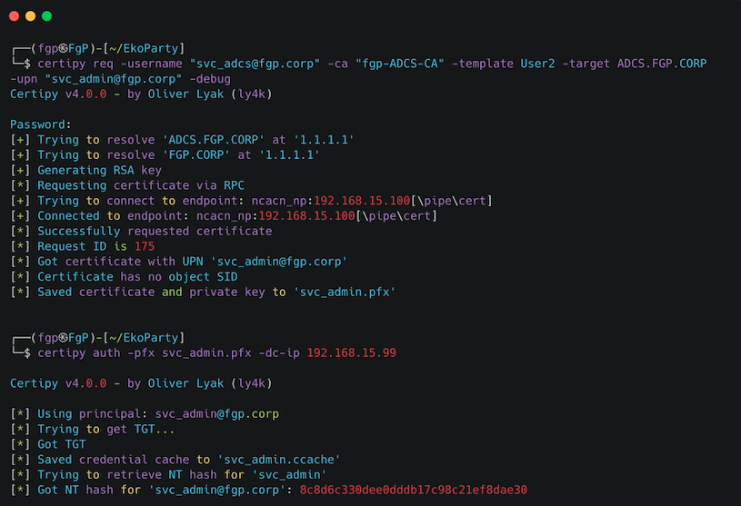
ESC1 — Exploited

Slide 16
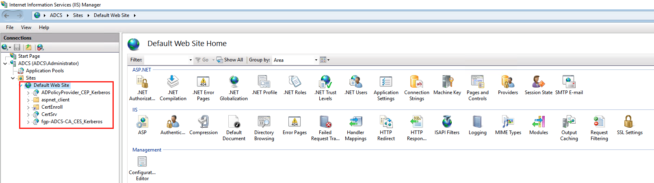
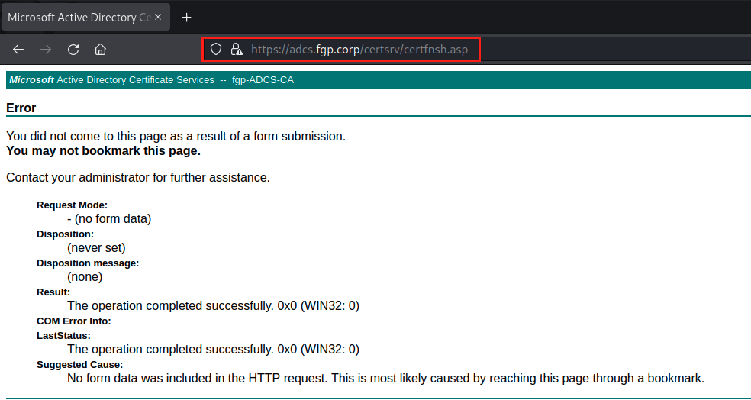
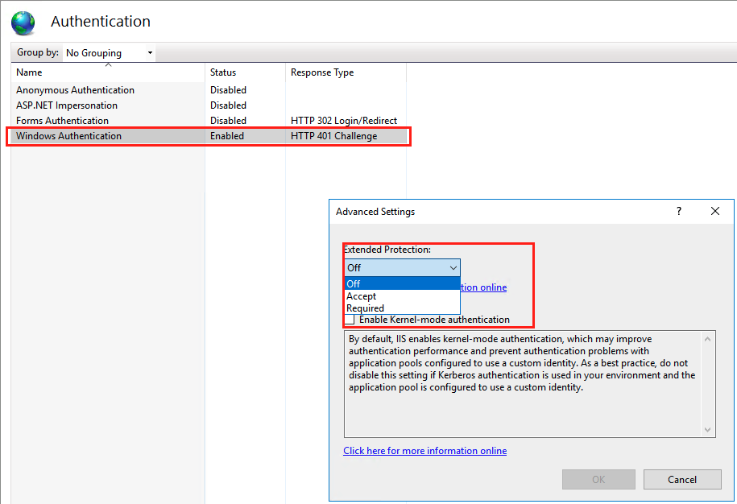
ESC8 - NTLM Relay and ADCS ​
​As covered in the “Certificate Enrollment” section, AD CS supports several HTTP-based enrollment methods via additional AD CS server roles that administrators can install. ​
These HTTPbased certificate enrollment interfaces are all vulnerable NTLM relay attacks. Using NTLM relay, an attacker on a compromised machine can impersonate any inbound-NTLM-authenticating AD account.​
While impersonating the victim account, an attacker could access these web interfaces and request a client authentication certificate based on the User or Machine certificate templates.
IIS Authentication ADCS Clients
Console Webservice - ADCS
The MICRO$OFT suggest enable KERBEROS Authentication.

Slide 17
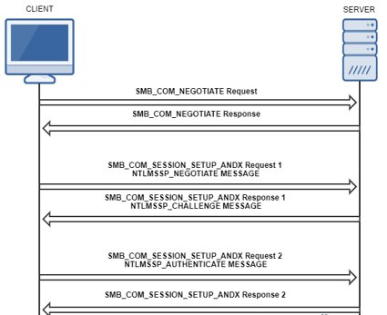
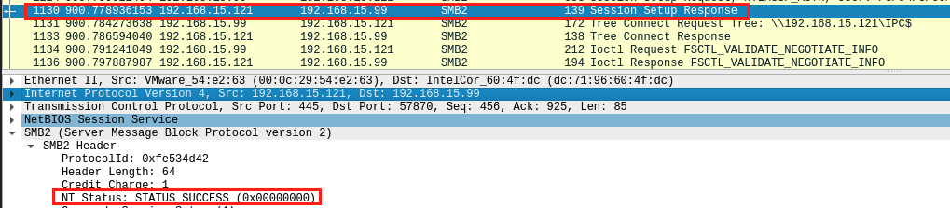
Back to the Basic – NTLM​
In NTLM, a challenge-response protocol is used for authentication. For any authentication request:​
​
NTLM establishes a three-way handshake during client-server authentication with the client establishing a path to the server and negotiating authentication.​
​2) The server responds to the client’s negotiation message with a challenge, asking the client to encrypt a sequence of characters using a secret it possesses: a hash of its password.​
​3) The client sends a response to the server, which contacts a domain authentication service hosted on a domain controller to verify the response.​
​
In a NTLM relay attack, an attacker establishes a position between the client and server on the network and intercepts authentication traffic. ​
Client authentication requests are forwarded to the server by the attacker, similarly challenges are relayed to the client and valid authentication ​
responses to the challenge from the client are sent back to the server, allowing the attacker—rather than the client—to authenticate using the client’s credentials.

Slide 18
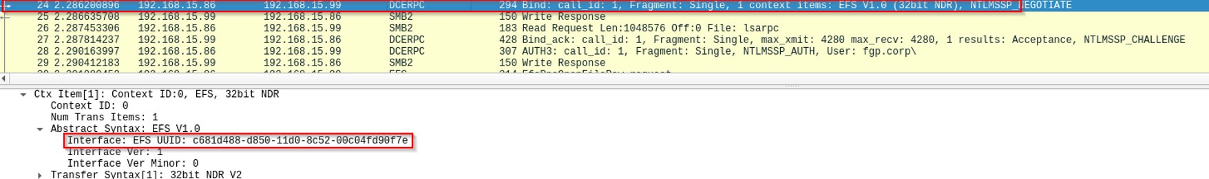
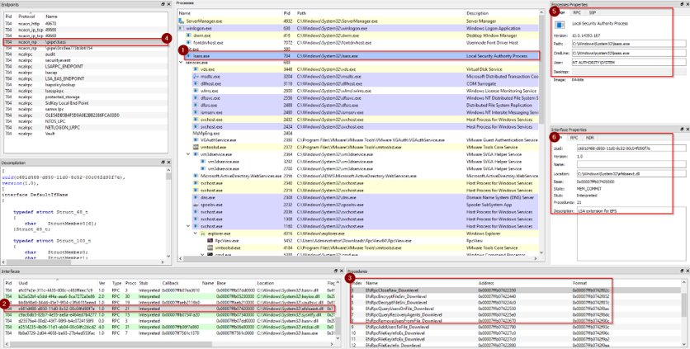
EFSRPC and RPC
The Encrypting File System Remote Protocol (hereafter referred to as EFSRPC) is a Remote Procedure Call (RPC) interface that is used to manage data objects stored in an encrypted form. The objective of encrypting data in this fashion is to enforce access control policies and to provide confidentiality from unauthorized users

Slide 19
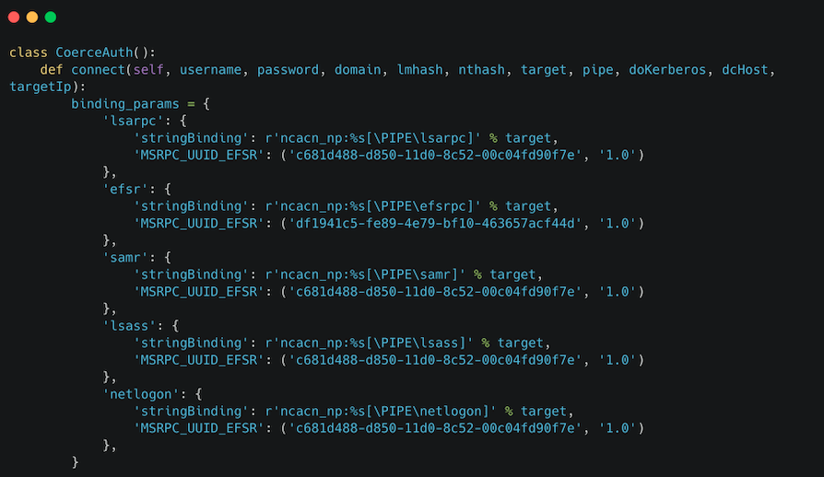
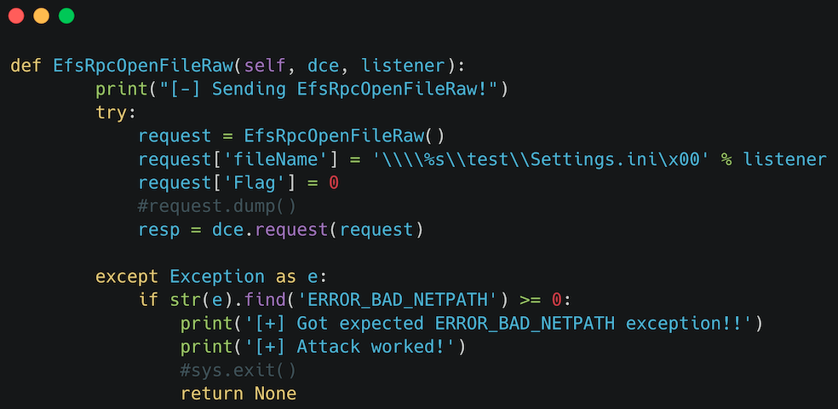
EFSRPC and RPC
In a hypothetical PetitPotam attack, the attacker abuses the Windows API function EfsRpcOpenFileRaw, which forces the server to connect to the location the attacker inserts into the FileName parameter. When the attacker passes along their own IP address in the FileName parameter, the server just connects to the attacker’s machine, which is running an SMB server and relays the SMB traffic on behalf of the attacker.​

Slide 20
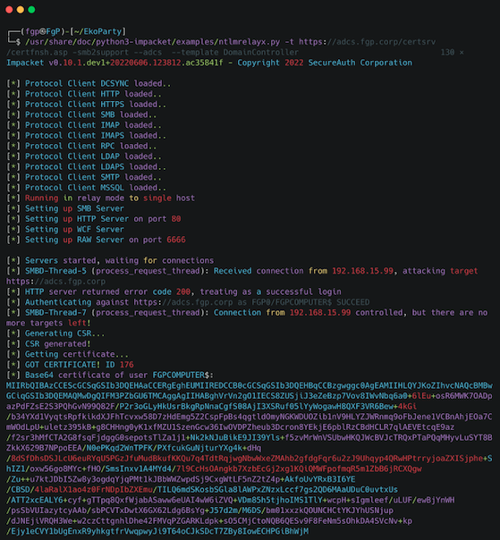
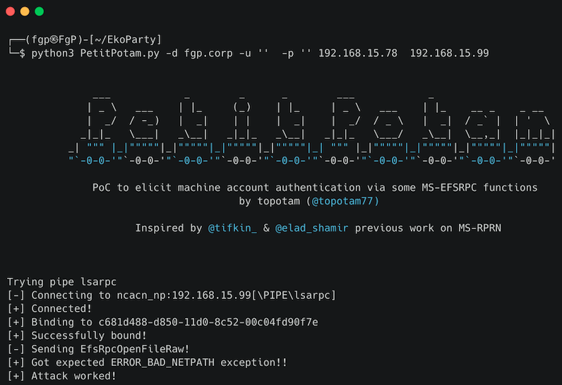
NTLM Relay and PetitPotam​
Running the PoC don’t requires username and password ​ ​

Slide 21
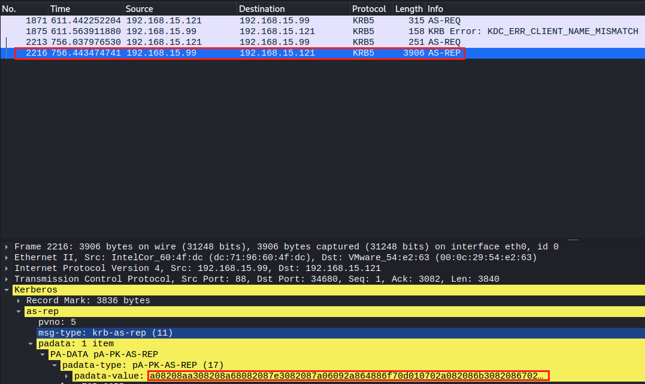
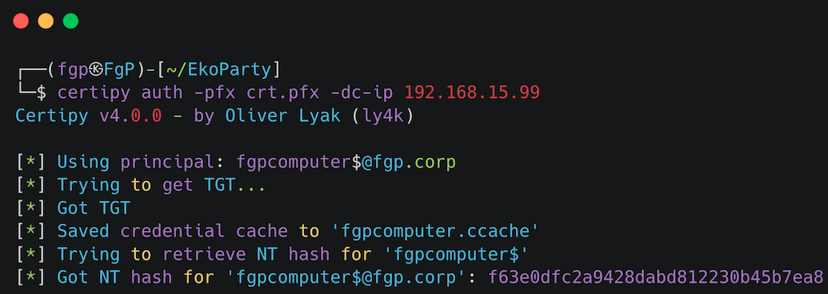
Kerberos TGT
Kerberos is a network authentication protocol based on tickets. The protocol allows 2 parties (a client and a server) to authenticate to each other over an insecure network channel, provided that both parties trust a third party; the KDC! ​
​
The main components of a Kerberos transaction are:​ - The KDC (Key Distribution Center)​ - The client requesting access​ - The service the client is attempting to obtain access to While Kerberos, is the preferred mechanism, Windows will revert to NTLMv2 if Kerberos is not​ available (unless explicitly disabled) ​
​
Kerberos uses shared secrets for authentication In a Windows domain there is only one, the NTLM Hash The password hash is used to encrypt everything in MS Kerberos​
​
There are many components in Kerberos protocol, but we focus only on:​
​
KRB_AS_REQ​
KRB_AS_REP​
KRB_TGS_REQ​
KRB_TGS_REP​

Slide 22


Slide 23
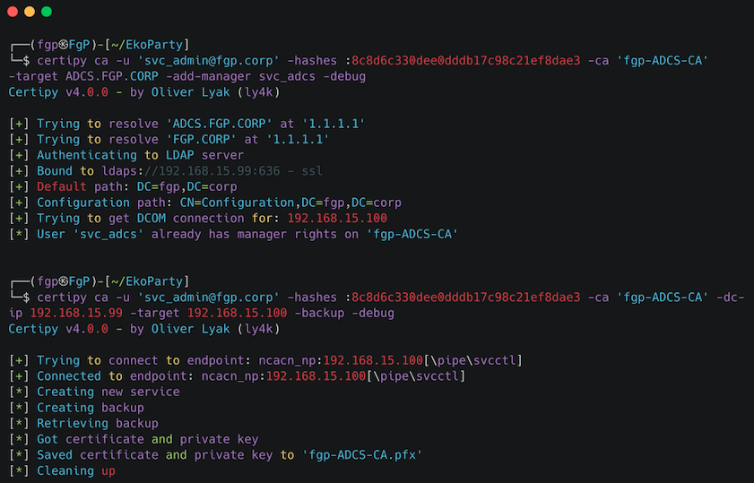
ESC7 – Yes, I’m the Manager of FGP-ADCS-CA​
ESC7 is when a user has the Manage CA or Manage Certificates access right on a CA. While there are no public techniques that can abuse only the Manage Certificates access right for domain privilege escalation, we can still use it to issue or deny pending certificate requests.
Added a new Manager and Backup all CA

Slide 24
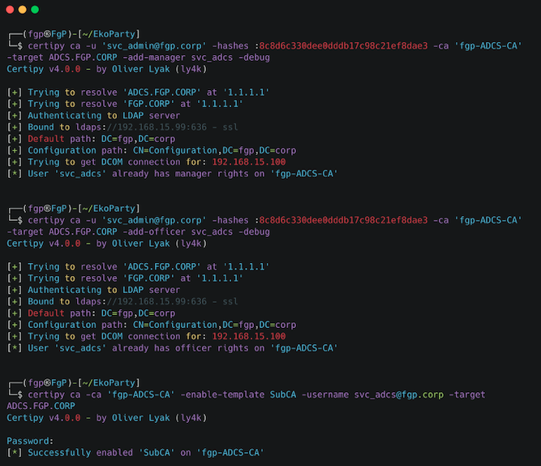
Seriously? Do you think you fixed ADCS missing configuration? Let me see
To this attacks work we need have right access "Manager Certificate" this access is equivalent "add-officer”.
This is the problem? Remember we are manager CA then we can become the officer CA right now
Enable Template SubCA

Slide 25
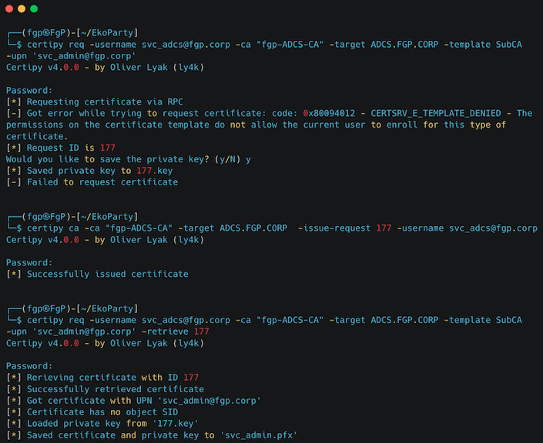
Seriously? Do you think you fixed ADCS missing configuration? Let me see
Don’t Forget We are Manager CA
Request new Certificate with Private Key

Slide 26

PoC – All the thing together Mitigation

Slide 27
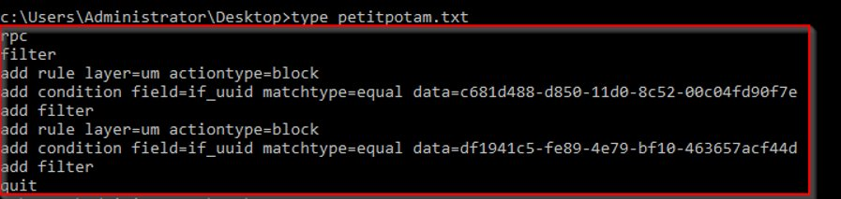
Mitigations
ESC1 ​
​
There are a few options. First, right click the affected certificate template in the Certificate Templates Console (certtmpl.msc) and click "Properties”​
​
Remove the CT_FLAG_ENROLLEE_SUPPLIES_SUBJECT flag via "Subject Name", unchecking "Supply in Request".​.​
​
Remove the "Client Authentication" and/or "Smart Card Logon" EKUS via "Extensions" -> "Application Policies".​
Enable "CA Certificate Manager Approval" in "Issuance Requirements".​
​
ESC8​
​
Don´t ask to Microsoft, ask to Twitter​

Slide 28
Thank you
And
Questions

